Slide 1
USER INTERFACES for EMBEDDED SYSTEMS
Lecture 9: Statistics
Stefan Wagner
sw@eng.au.dk

Slide 2
Agenda
Introduction
Descriptive statistics
Central tendency and variability
Visualizing data with charts and graphs
Histogram and boxplot
t-test
Correlations

Slide 3
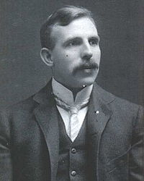
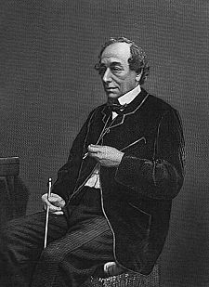
Statistics as a phenomena
“If your experiment needs statistics, you ought to have done a better experiment“
Ernest Rutherford (nuclear physicist)
“There are three kinds of lies: lies, damned lies, and statistics”
Benjamin Disraeli (British statesman and literary figure)
Mark Twain (novelist)

Slide 4
Descriptive statistics
Describes data in a sample
Does not infer anything about the population
Collect, classify, summarize, and present data
Proceed to inferential statistics if
There is enough data to infer about the population
Your data is representative of the population
Remember: With statistics
You do not prove a correlation or causality
You merely render a correlation probable

Slide 5
Populations and samples (1/2)
Statistics are calculated from the samples
Inferences are made from the sample to the population
In descriptive statistics we only look at samples
Population
(All individuals of interest)
Results from the
sample are generalized
to the population
A sample is selected
from the population
Sample
(Selected subset of pop.)

Slide 6
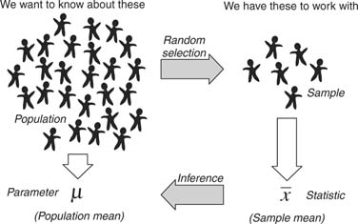
Populations and samples (2/2)

Slide 7
Notation and terminology
A statistical parameter is a single measure of some attribute of a population
e.g. artithmetic mean
A statistic is a single measure of some attribute of a sample
e.g. arithmetic mean
E.g, the sample mean is a statistic which estimates the population mean, which is a statistical parameter

Slide 8

Types of data
Nominal data
unorderd data, cannot be compared, apples vs bananas
Ordinal data
Ordered data that can be compared, task performance 10 seconds vs 30 seconds
Poor vs good, relative ranking, is number 3 is better than 6, but is it 2 times better?
Interval data
From a scale 1-10
Range data
Interval data with a specified offset (e.g. all tests starts with 0 seconds to infinity)

Slide 9
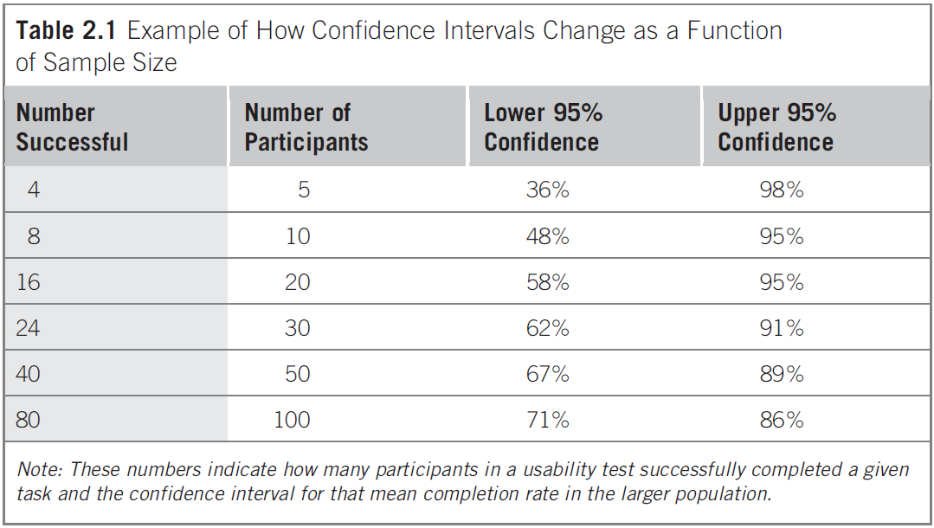
Sample size & Confidence intervals
Central question:
how many participants are needed”?
Sample size:
Three to four participants might be enough for some studies
Other studies might need thousands of participants
Confidence intervals indicates how results can be generalized
E.g. with 95 % confidence we can say that between 36 and 98 % of larger population will be able to successfully complete a given task when using a sample n=5
With n=100 the 95% confidence interval numbers are 71% to 86%. Larger samples, higher confidence.

Slide 10
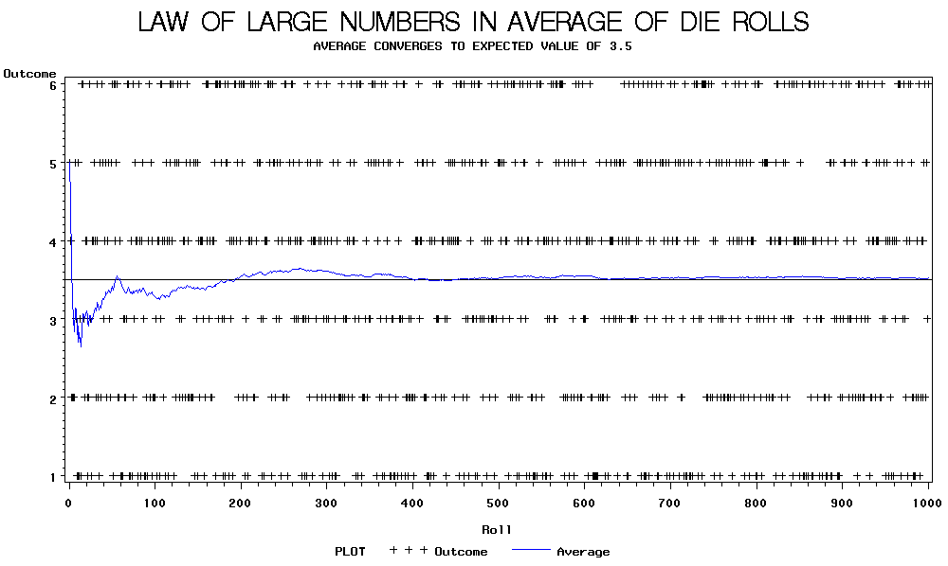
Law of large numbers: Die roll example
Notes:
rolls=900; faces=6; outcomes=randi(faces,1,rolls); plot(1:rolls,outcomes,'.:'); hold on; plot(1:rolls,mean(outcomes),'ro');

Slide 11
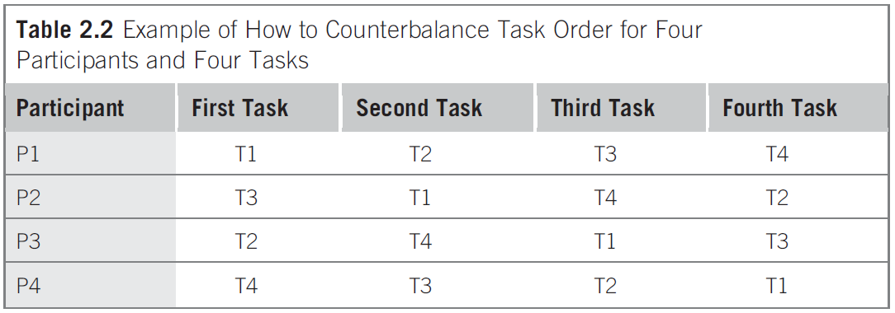
Counter balancing
Avoid or negate a learning effect by using counter balancing

Slide 12
Applied Descriptive statistics
Descriptive statistics:
are essential for any interval or ratio-level data. Descriptive statistics, as the name implies, describe the data without saying anything about the larger population.
Inferential statistics:
let you draw some conclusions or infer something about a larger population above and beyond your sample.
Descriptive statistics are very easy to calculate using most statistical software packages.
Inferential statistics are more difficult and error prone.

Slide 13
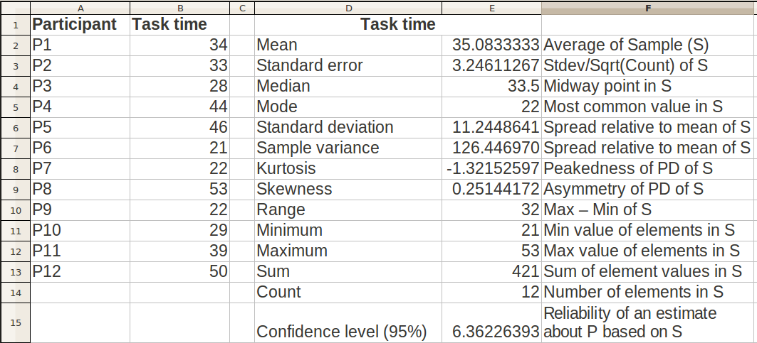
Applied Descriptive statistics: Common measures
(sample std)
Central tendency measures
Variability measures
Other measures
[Tullis08]

Slide 14
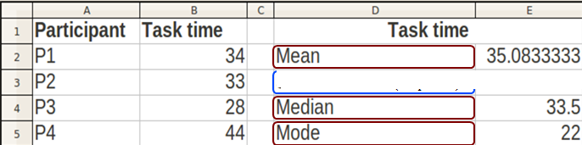
Central tendency
Clustering around a central measure
Mean, Median, and Mode
Median location = 50th percentile
Mode, i.e. the most commonly occuring score

Slide 15
Variability
Spread of data “measured” as “distance” to central tendency
The larger the spread - the more data you need for higher confidence
Sample range
distance between max and minimum
Identifies outliers and coding errors (e.g. if scale is 1-5, a zero value is wrong)
Sample variance
estimator for population variance relative to the mean value
Sample standard deviation –
estimator for population standard deviation – e.g. an average of 10 seconds
Confidence interval (in Excel)
= confidence (alpha, standard deviation, sample size)
alpha = significance level (often 0,05 - 0,01): meaning how certain do we want to be

Slide 16
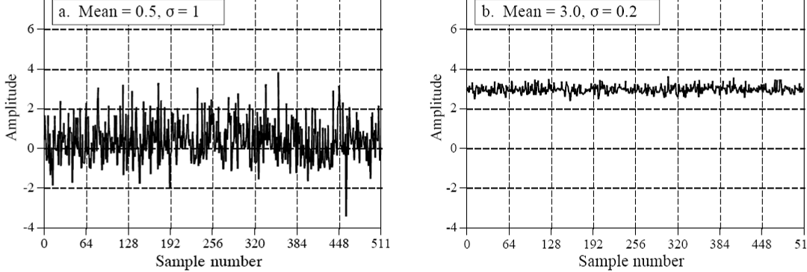
Example: Sample mean and sample standard deviation
[Smith97]

Slide 17
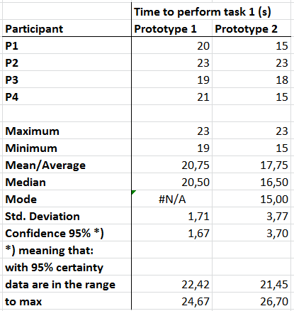
Exercise
45 minutes Exercise
1) Recruit four(+) participants from your peer group
2) Have them solve a specified task from your scenario using your two prototypes
3) Record for each participant:
3.1) Time to solve task using prototype 1
3.2) Time to solve task using prototype 2
4) Enter the data into excel
5) Calculate the mean, median, mode for each column (=AVERAGE, =MEDIAN, =MODE)
6) Calculate the standard deviation, and the confidence interval (=STDEV.S(C5:C8))
7) Calculate the 95% Confidence
8) Calculate the Confidence Interval

Slide 18
Visualizing data in graphs
Precision and clarity is a virtue and necessity in any field of science
Please remember
Label diagrams and axes
Always remember units (SI)
Do not imply more precision than data allows, e.g. decimals
Careful if using colors and fancy diagram types, e.g. 3D
Do not overload diagrams with information
Use confidence intervals whenever possible

Slide 19
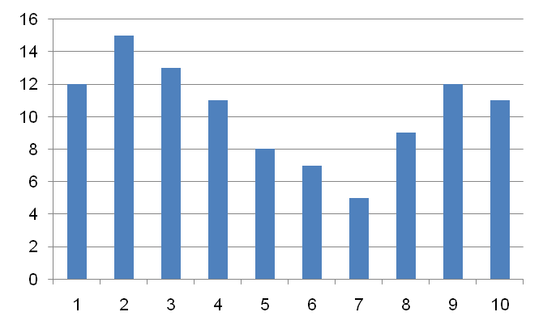
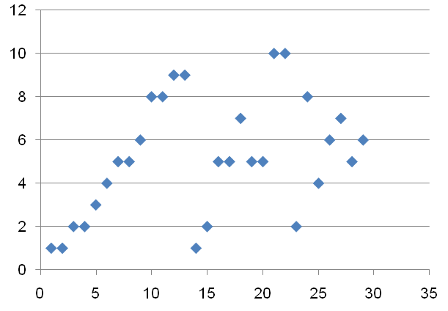
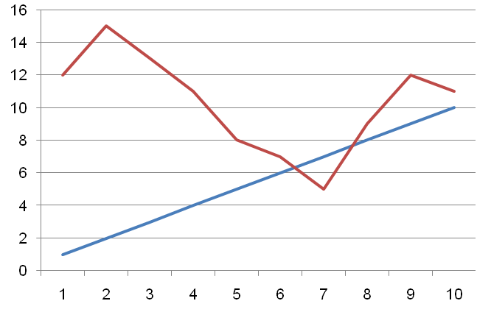
Histograms, graphs, and plots
What is wrong with these?

Slide 20
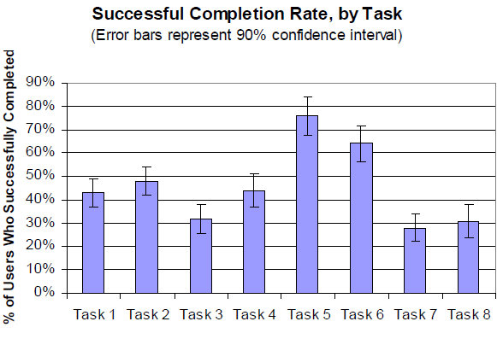
Graphs with confidence intervals

Slide 21
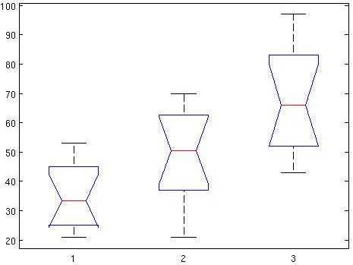
Boxplot
E.g. comparing means of three independent samples
Boxplot (overview): Design A Design B Design C
Q3 = 75th percentile
Q2 = Median
Q1 = 25th percentile
Q1 – 1.5 * IQR
Notes:
Kvartiler
1. Kvartil / nedre kvartil / 25% percentil:
2. Kvartil / median / 50% percentil:
3. Kvartil / øvre kvartil / 75% percentil
Kvartiler forklaret:
1. kvartil er den mindste observation, hvor alle de observationer, der er mindre eller lig den udgør mindst en fjerdedel af alle observationer.
2. kvartil: Det samme som ovenfor nu bare med halv-del i stedet for fjerde-del
3. kvartil: Det samme som ovenfor nu bare med tre fjerde-dele i stedet.

Slide 22
Top 10 mistakes in data graphs
Not labeling axes or units
Implying more precision in your data than it deserves
Not showing confidence intervals when you can
Not starting a bar graph at lowest possible y-axis value (usually 0)
Using a line graph when it should be a bar graph
Using 3D when it doesn’t add any value
Trying to include too much
Poor labeling of pie charts
Using colors as the only way to convey information
Not knowing when to use stacked bar graphs
[Tullis08]

Slide 23
Suggested software
Excel, Open Office Calc and other spreadsheets
Matlab (ENG and ASE uses this)
SPSS (Statistical Package for the Social Sciences)
STATA (Aarhus University Hospital uses this)
STATISTICA
R (free)
GNU Octave (free)

Slide 24
Comparing samples
Is prototype 1 more efficient than 2?
Just compare means and medians for simple comparison
Use statistical tests for comparing means with greater power
For small populations (n < 30) e.g. use t-test
For larger populations use z-test ( n > 29)
Comparing two samples use t-test, more than two use ANNOVA
Independent samples
If you compare two different groups (e.g. novice users to experienced users)
Use an unpaired t-test
Dependent samples
If you compare the same group of participants – using two different prototypes
Use a paried t-test

Slide 25
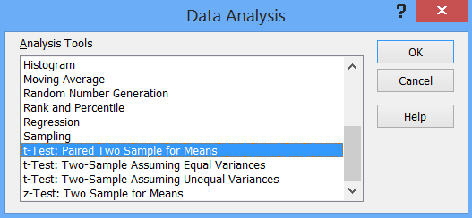
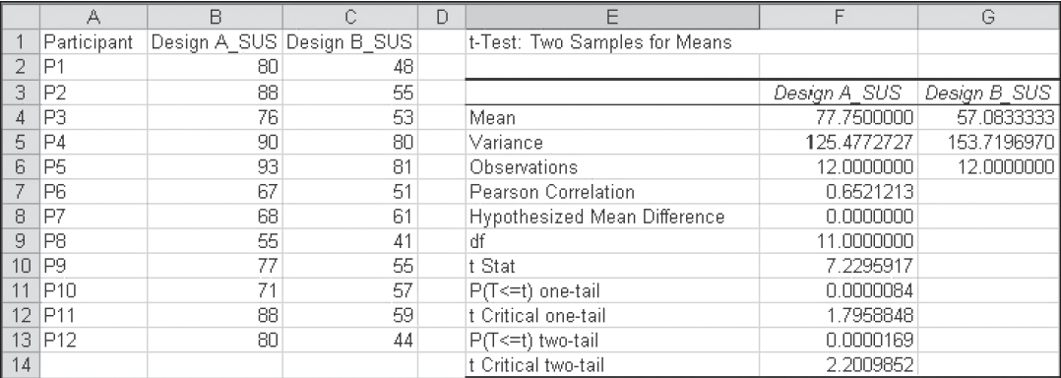
Paired t-test

Slide 26
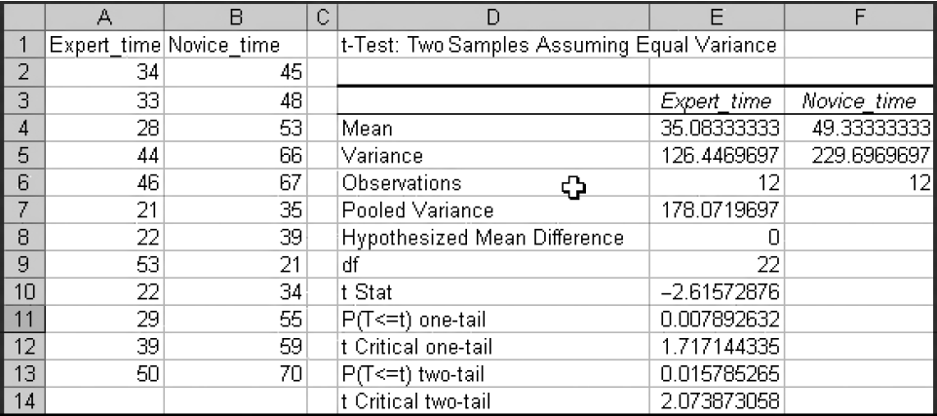
Unpaired t-test

Slide 27
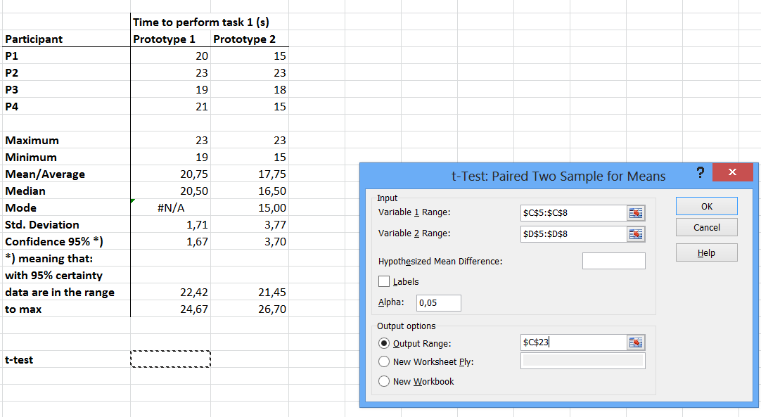
T-test in excel

Slide 28
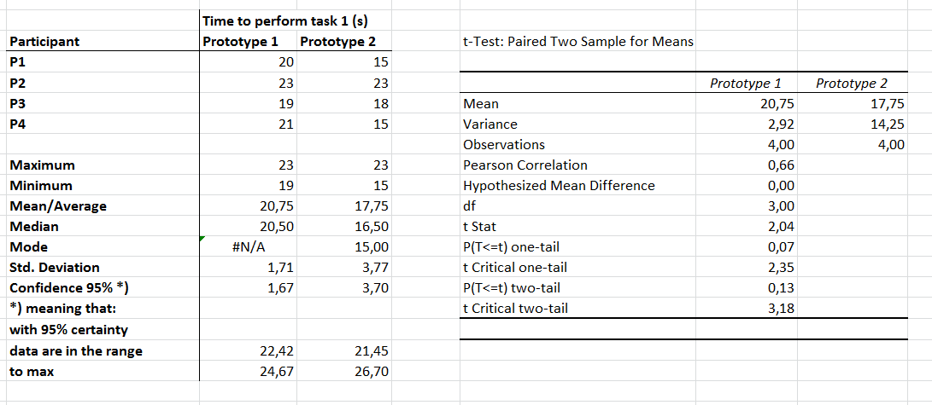
T-test
So given the assumption (hypothesis) – that there is no difference between tasks times
between prototype 1 and 2, there is p = 0.07 that this is the case.
p should be lower than 0.05 for significance (95%) , and p < 0.01 (99%) for high significance.
Thus, data are not significantly different … but close

Slide 29
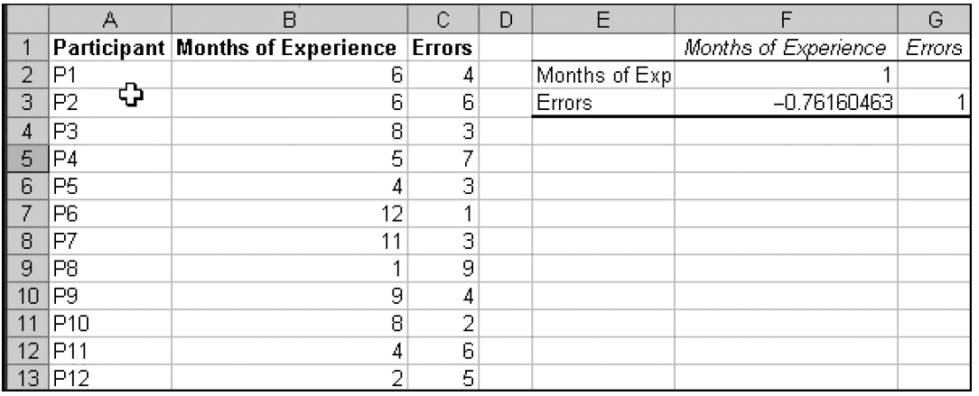
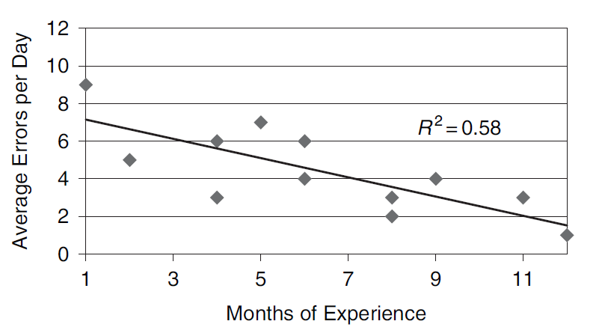
Correlations
Investigating whether parameters has a relationship

Slide 30
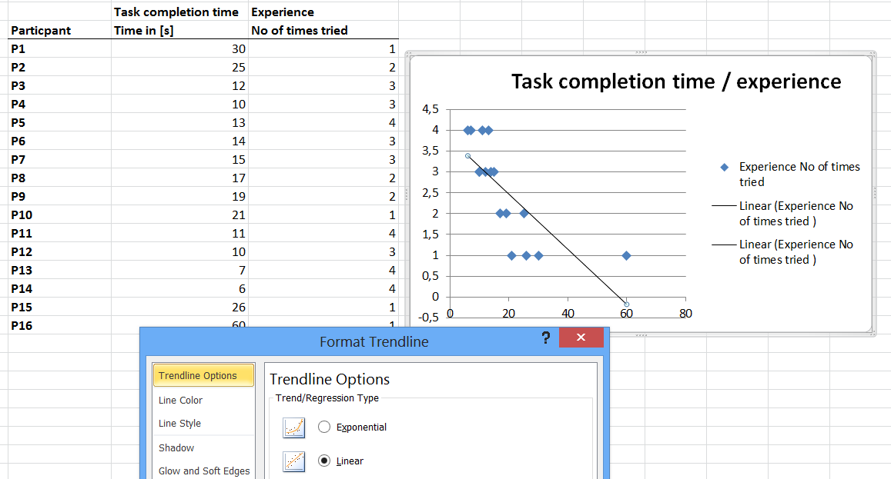
Adding trend lines / regression analysis

Slide 31
References
[Tullis08] Tullis and Albert, Measuring the User Experience, 2008
[Sharp02] Sharp, Rogers, and Preece, Interaction Design, 2002
[Nielsen94] Jakob Nielsen, Usability Engineering, 1994
[Rubin94] Jeffrey Rubin, Handbook of Usability Testing, 1994
[Garret02] J.J. Garret, The Elements of User Experience, 2002
[IDBook11] www.id-book.com
[Popper68] Popper, K. R. The Logic of Scientific Discovery. London: Hutchinson
[Smith97] S.W. Smith, The Scientist and Engineer's Guide to Digital Signal Processing, California Technical Publishing, 1997

